Slide 1




To follow the project documentation or follow the slides
z

Slide 2
Tecnhology around us
Technology is truly around us?

Slide 3

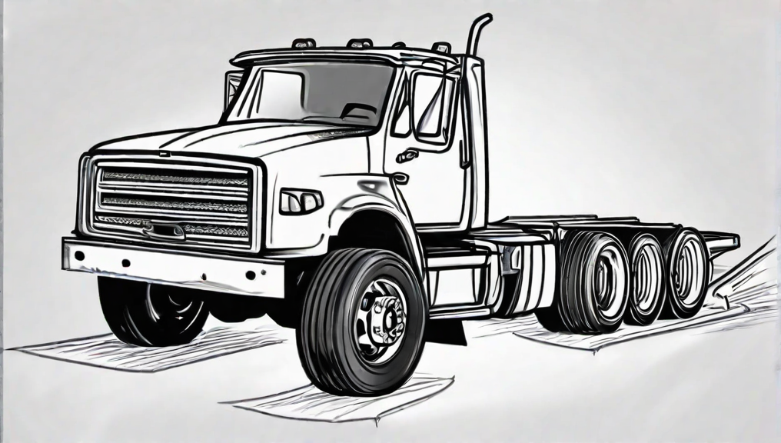

What we have?
z

Slide 4


So advanced in terms of technology but at the same time only few people have access to it
z

Slide 5

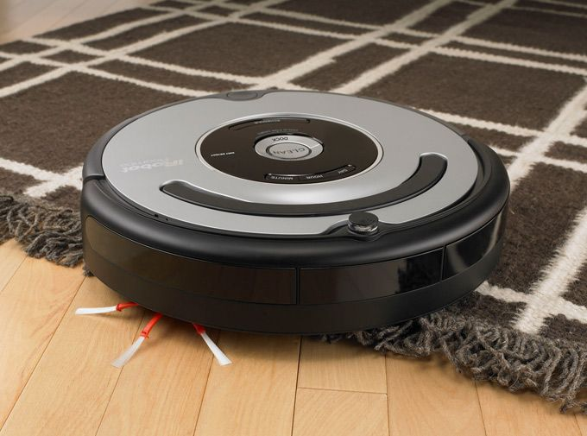
residentially speaking
z

Slide 6

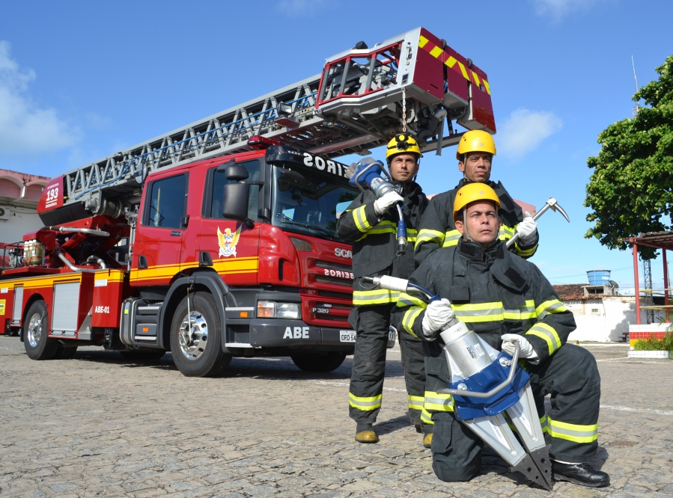
The process of development
residential
Public services
z

Slide 7
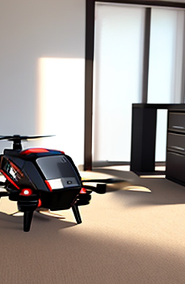

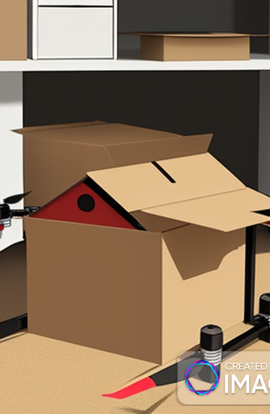
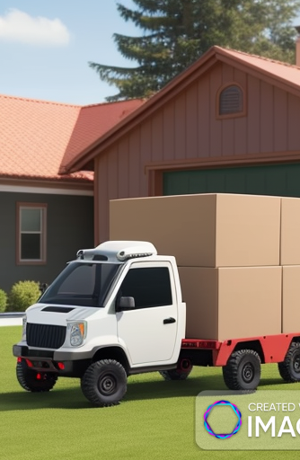
The solution
z
Resitentialy speaking

Slide 8
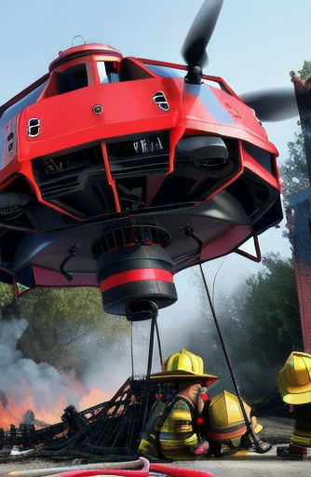



The solution
z
Public services

Slide 9
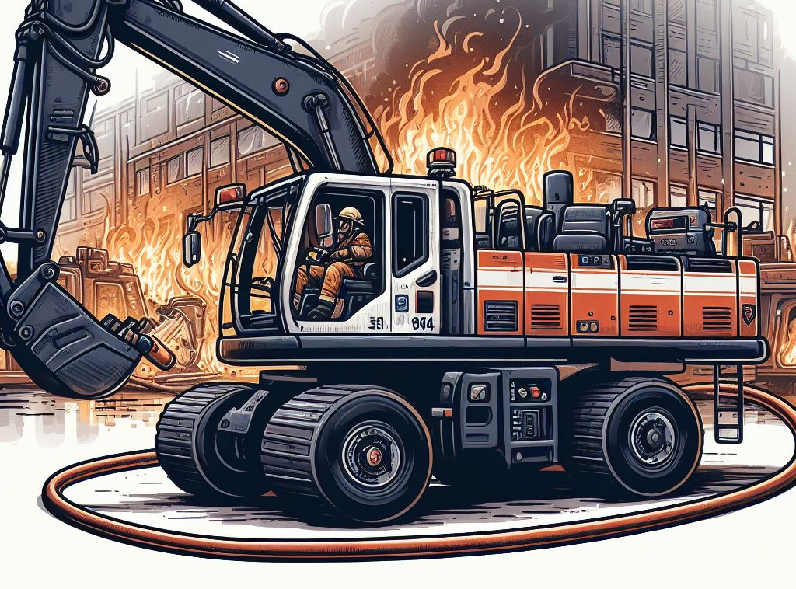

The solution
z
Heavy duty public services

Slide 10



The solution
z
Public services of security

Slide 11
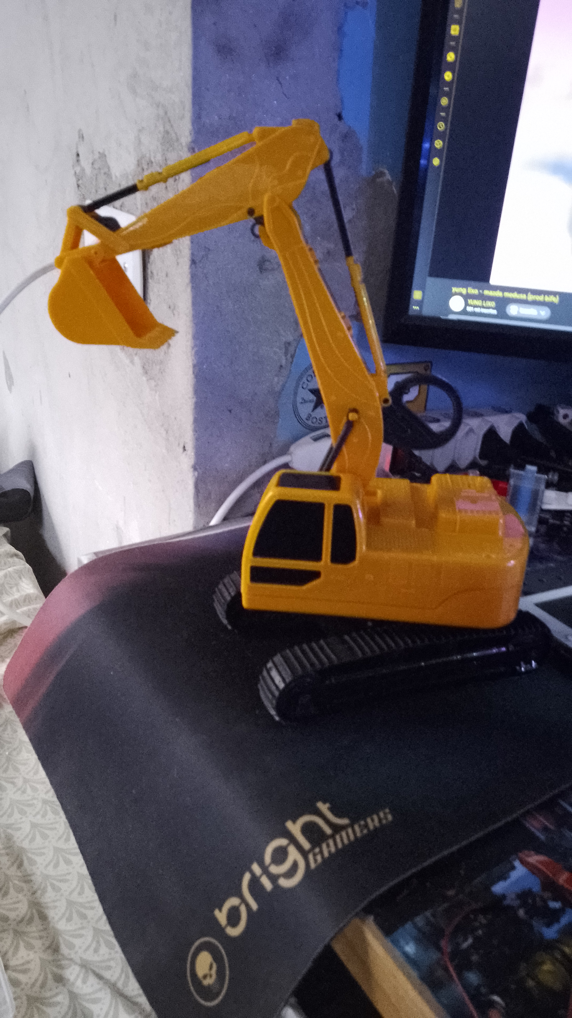
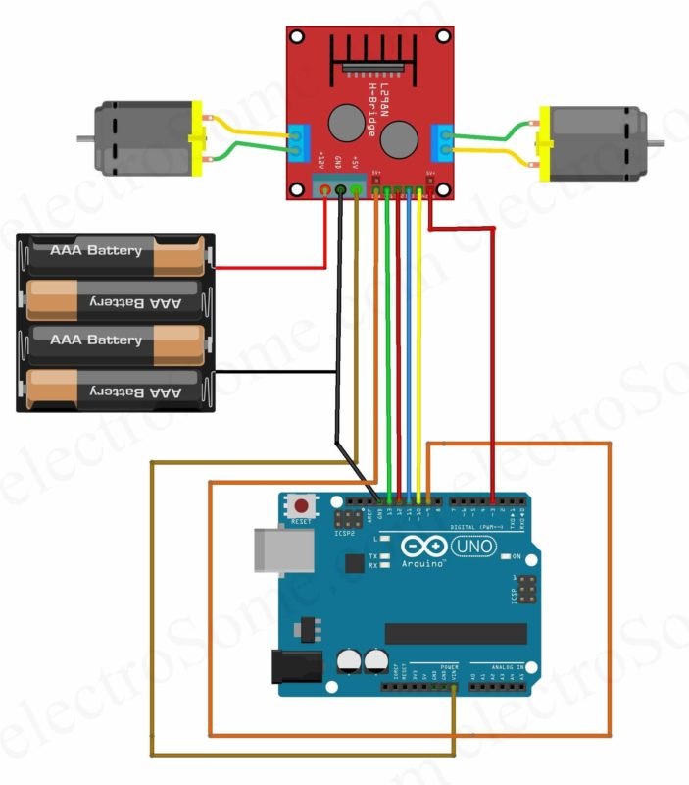
The prototype

Slide 12
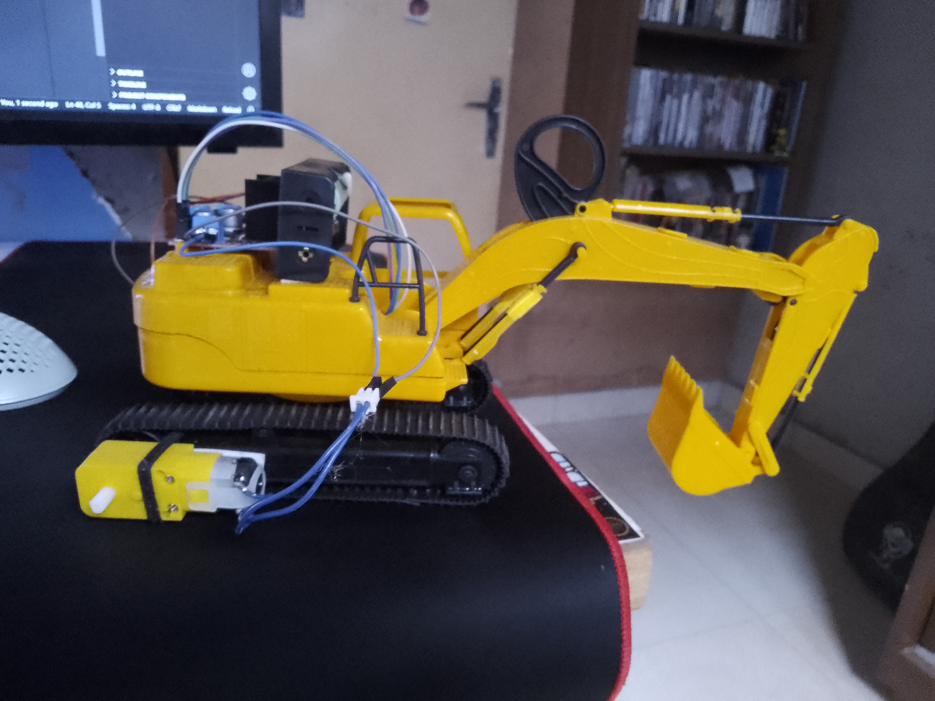
The final result

